Slide 1
Box Office success
May 2023
Team Jupiter
A Look into a Movies Success
- Ian Franklin
A look at how much a movie does in both gross ticket sales and return on investment..
Greensboro College – Data Science Program

Slide 2
Ian franklin
Team Jupiter
Biography
Background
New father
New Homeowner
Moved across country in July ’22
A learner, tinkerer, and curious cat
A reader and librarian without enough shelves
Maricopa Community Colleges & Greensboro College
Industry experience in Food, Labor, Manufacturing, Retail, Transportation, & Sales
Entrepreneur
github.com/IanFranklin

Slide 3
Movies BY THE NUMBERS
Team Jupiter
Hollywood provided $504 billion to the U.S. GDP before the pandemic period.
The U.S. film industry has a net worth of around $91.83 billion.
Hollywood
Streaming
According to the MPAA, in 2017 76% of people reported going to the movies at least once.
14% of American watch movies at the theaters once a month.
19% of U.S. adults watch or stream movies every day.
26% state that they watch movies several times per week.

Slide 4
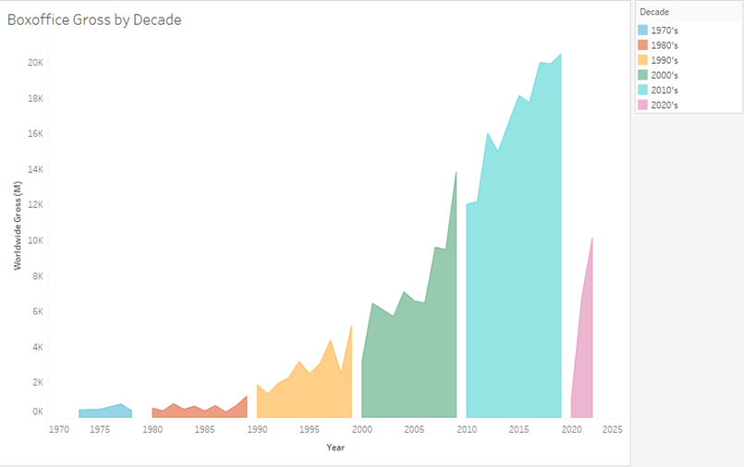
Movies BY THE NUMBERS
Team Jupiter
And yet…
Despite competition, annual ticket sales have remained relatively stable for the past 10 years.
How can data help movie makers?
Can data be used to help decide optimal movie budgets?
Are certain genres of movies a better return on money?

Slide 5
Methods
Team Jupiter
Datasets
Programs Used
The Hollywood Insider Data
Most Profitable Movies – Top 500
informationisbeautiful.net
MS Suite (Excel, PowerPoint, Word)
Python
Jupyter Notebook
Slack
Wrangling
Created data frames copies
Reformatted column values
Recoded column values
Transformed variable values

Slide 6

Team Jupiter
Does big budget equal success?
Does a movies budget influence box office success?
Can a movie studio determine how much they expect to gross based on the budget?
Is Bigger Better?
More elaborate set
Stunning special effects
Recognized actors
Renowned directors
Linear Regression

Slide 7

Profitability
Team Jupiter
Can data determine what the most profitable genre is for movie studios?
Movie ROI
Which genres have the greatest return on investment ?

Slide 8
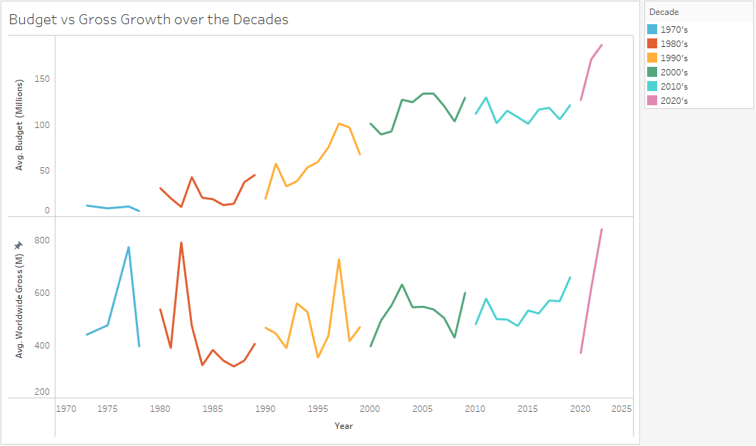
Team Jupiter
Does big budget equal success?
Over time the avg. Budget has steadily increased.
While Worldwide Gross has been mostly consistent with a slow increase.
Linear Regression

Slide 9
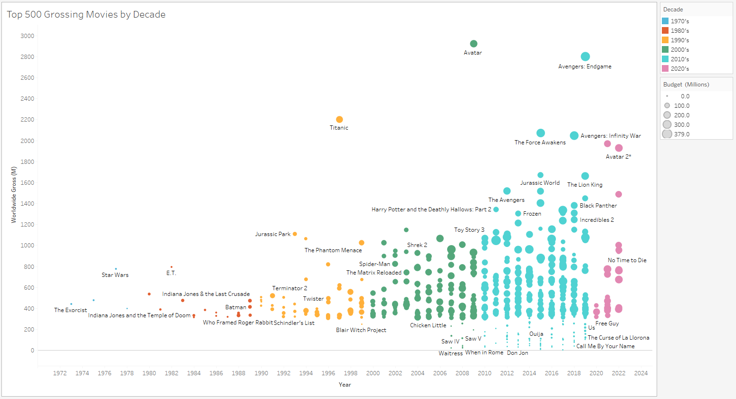
Team Jupiter
Does big budget equal success?
The 2010’s saw a return of smaller budget movies.

Slide 10
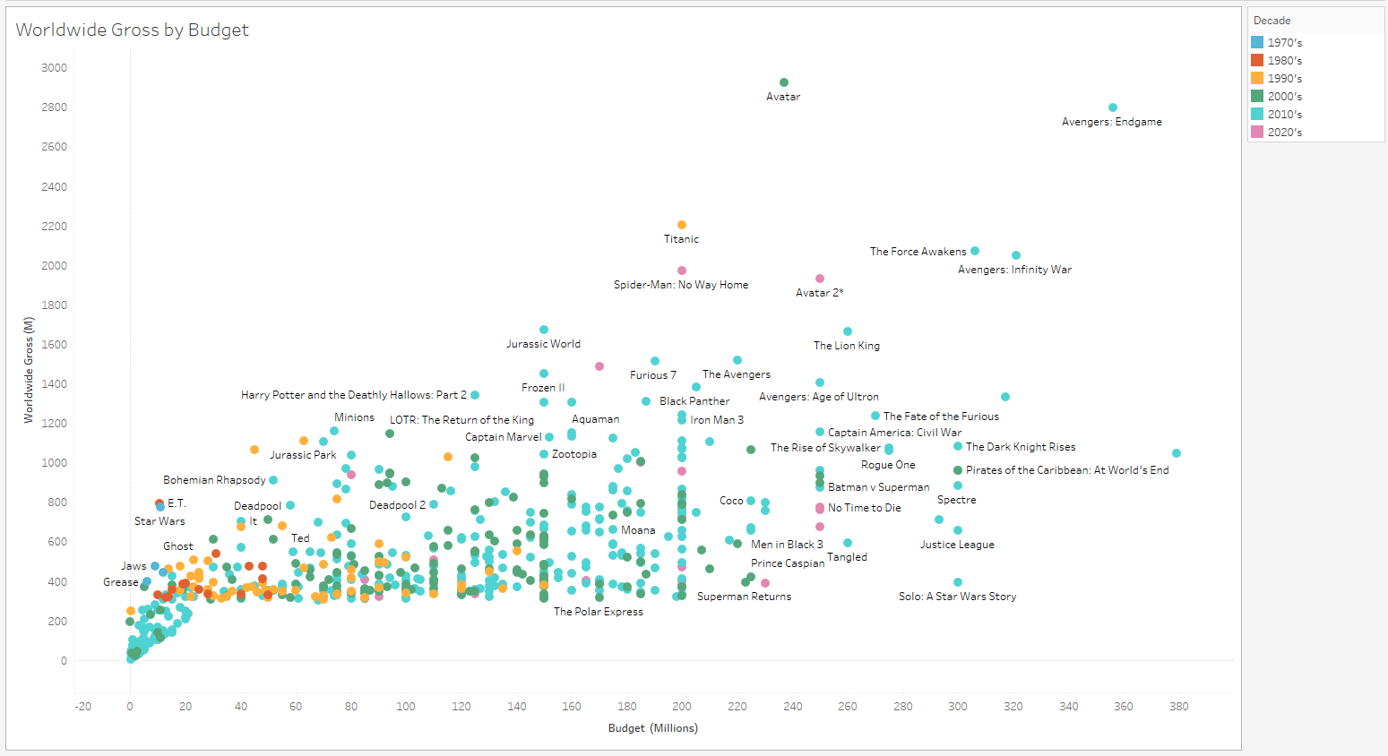
Team Jupiter
Does big budget equal success?
Does the amount of movie spent on making a movie influence box office sales?
Linear Regression
Looking at how a movies budget (millions) affects Worldwide or Domestic Gross

Slide 11
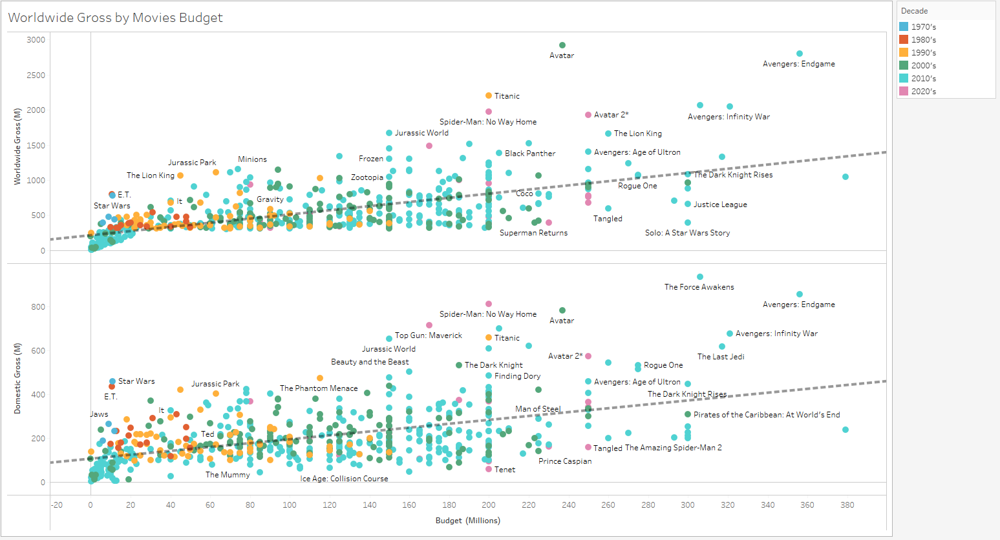
Team Jupiter
Does big budget equal success?
Linear Regression
A movie's Budget has a significant effect on how much a movie grosses Worldwide.
A movies budget size has less of an effect on Gross in the US than worldwide!
Do Americans prefer smaller budget, indie type movies or do only the big budget movies get promotion/advertising worldwide?

Slide 12
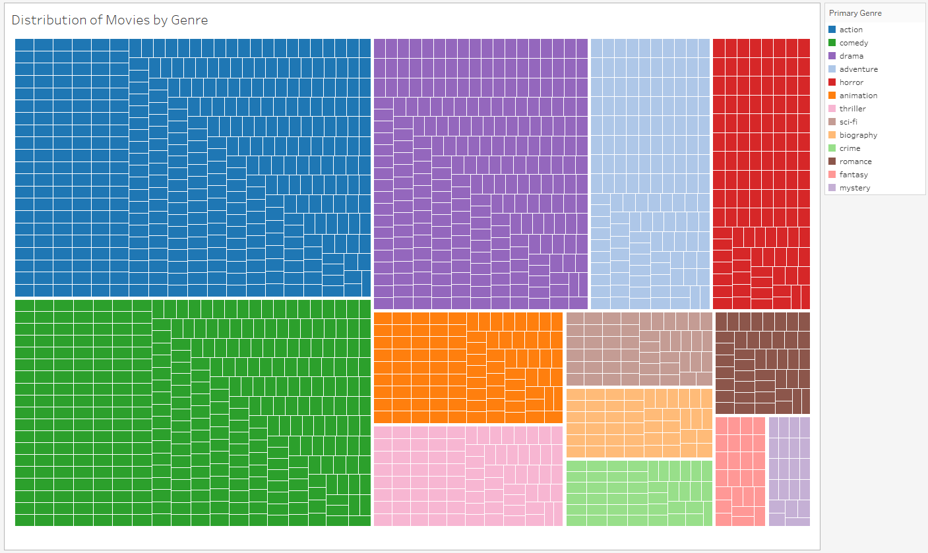
Profitability
Team Jupiter
Genre ROI
Good Movies = Profit?
Does a movies rating or genre influence how profitable a movie is?
Do higher rated movies have a better return on investment ?
Two Way ANOVA

Slide 13
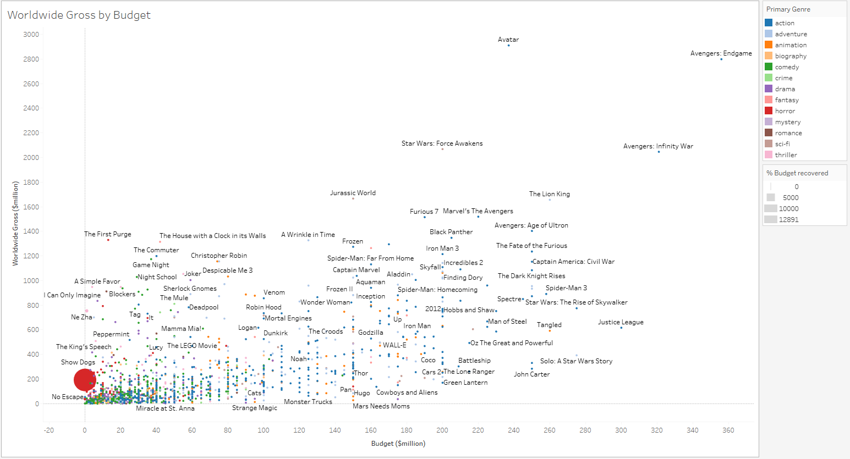
Profitability
Team Jupiter
Bigger budget films tend to be Action, Adventure, & Animation
Paranormal Activity made $193millon on a budget of $15,000
15% of movies did not turn a profit
37% made over a 1000x return on budget

Slide 14
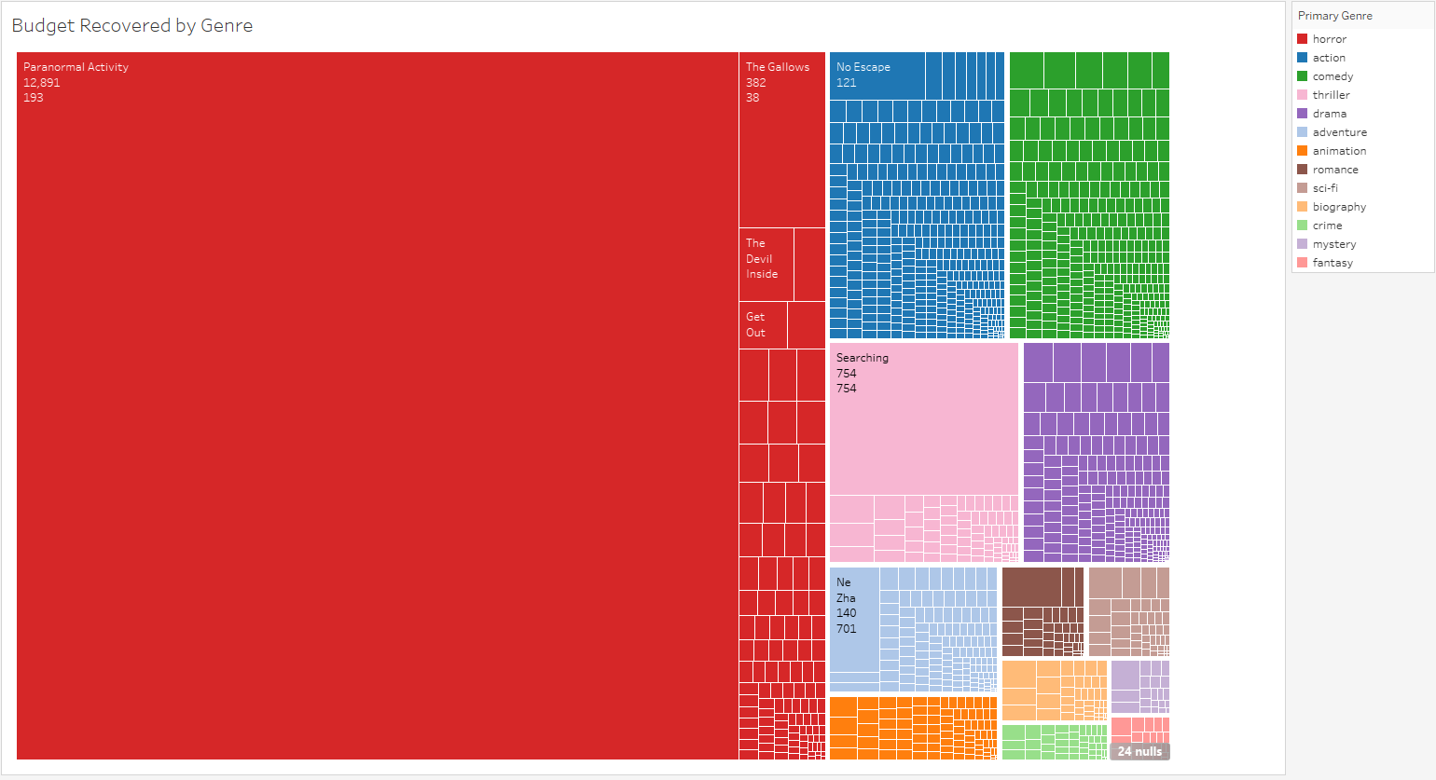
Profitability
Team Jupiter
Genre Returns
Correcting for Outliers
Horror and Thriller have the best return.
Crime, Mystery, & Fantasy have the lowest.
The thriller genre losses significance .
Mean for Horror drops by 92% but still eclipses other genres by 2 to 3 times the return on budget!!

Slide 15
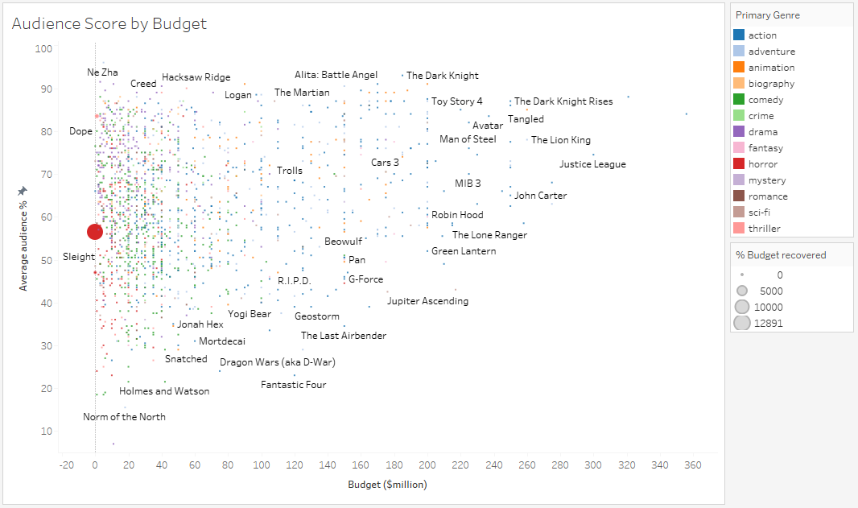
Profitability
Team Jupiter
Ratings Return
Correcting for Outliers
Ratings does have a significant effect on Budget recovered
Average movies has the worst return.
The lowest rated movies have the greatest return!
Two Way ANOVA

Slide 16
summary
Team Jupiter
Question #1
Question #1
A movies budget does have a significant effect on gross sales.
A movies budget does have a significant effect on gross sales.
Question #2
Genre has no overall significant effect on budget recovered, except Horror and Thriller movies due to extreme outliers.
Rating has no overall significant effect on budget recovered.
Question #2
Genre has no overall significant effect on budget recovered, except Horror and Thriller movies due to extreme outliers.
Rating has no overall significant effect on budget recovered.

Slide 17
Conclusions
Team Jupiter
Uses
This analysis can be used by small studios to help decide genre and budget amounts for new movie projects
Allows reader a macro level view of box office stats.
Importance
Shows off technical, analytical, & problem-solving skills.
Shows a curiosity and drive to dive into the rabbit hole.
How familiar topics can be approached in new ways.

Slide 18
Questions
May 2023
Team Jupiter
A Quick Look Back
- Ian Franklin
On how data can be used in the movie industry.
Greensboro College – Data Science Program

